Slide 1
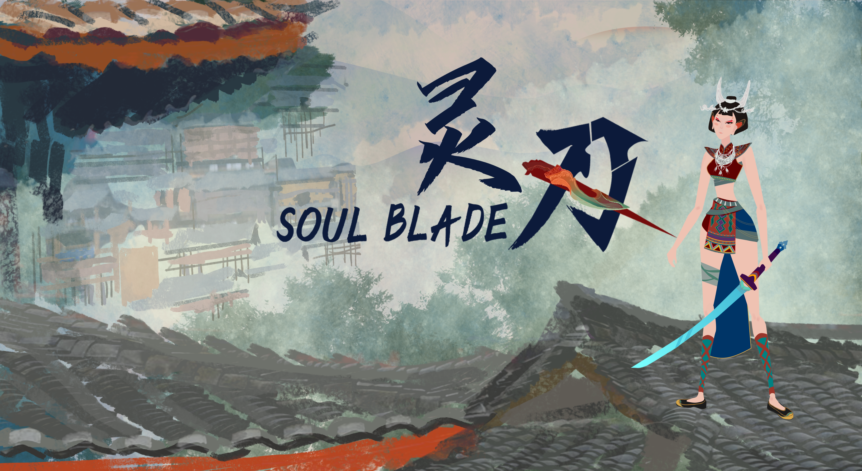
Elder Iron
Week 4

Slide 2
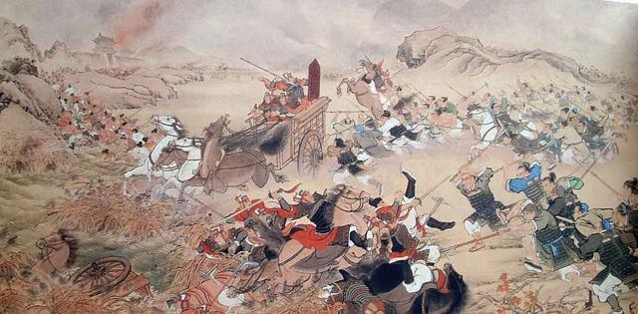
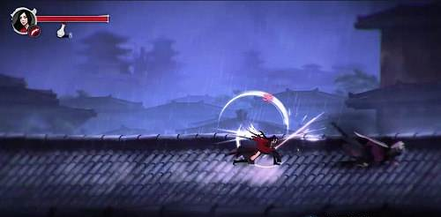
Final Proposal
Soul Blade is a 2D ACT game based on ancient Chinese mythology.
Engine: Unity
Number of player: Single player game
Art: Stylized art form
Core mechanism:
Combination of melee and range attacks;
Innovative, interesting combat and AI system;
An alternative interpretation of Chinese ancient mythology.

Slide 3
What can player experience?(Unique selling points)
Explore the story behind the character, the story end can be different depends on player’s choices.
Learn about ancient Chinese myths, a critical look at the history of 4,600 years ago, because history is written by the victors.
With the same game content, different fighting styles can bring different game experiences.
Experience beautiful and unique art styles.
Feedback from Chinese players:
‘Battle of Zhuolu’s story can be very interesting to present.’
‘The interaction between weapons and surroundings just like Getting Over It with Bennett Foddy.’
‘The attack of this game’s Character is cool and it give players many different choices.’

Slide 4
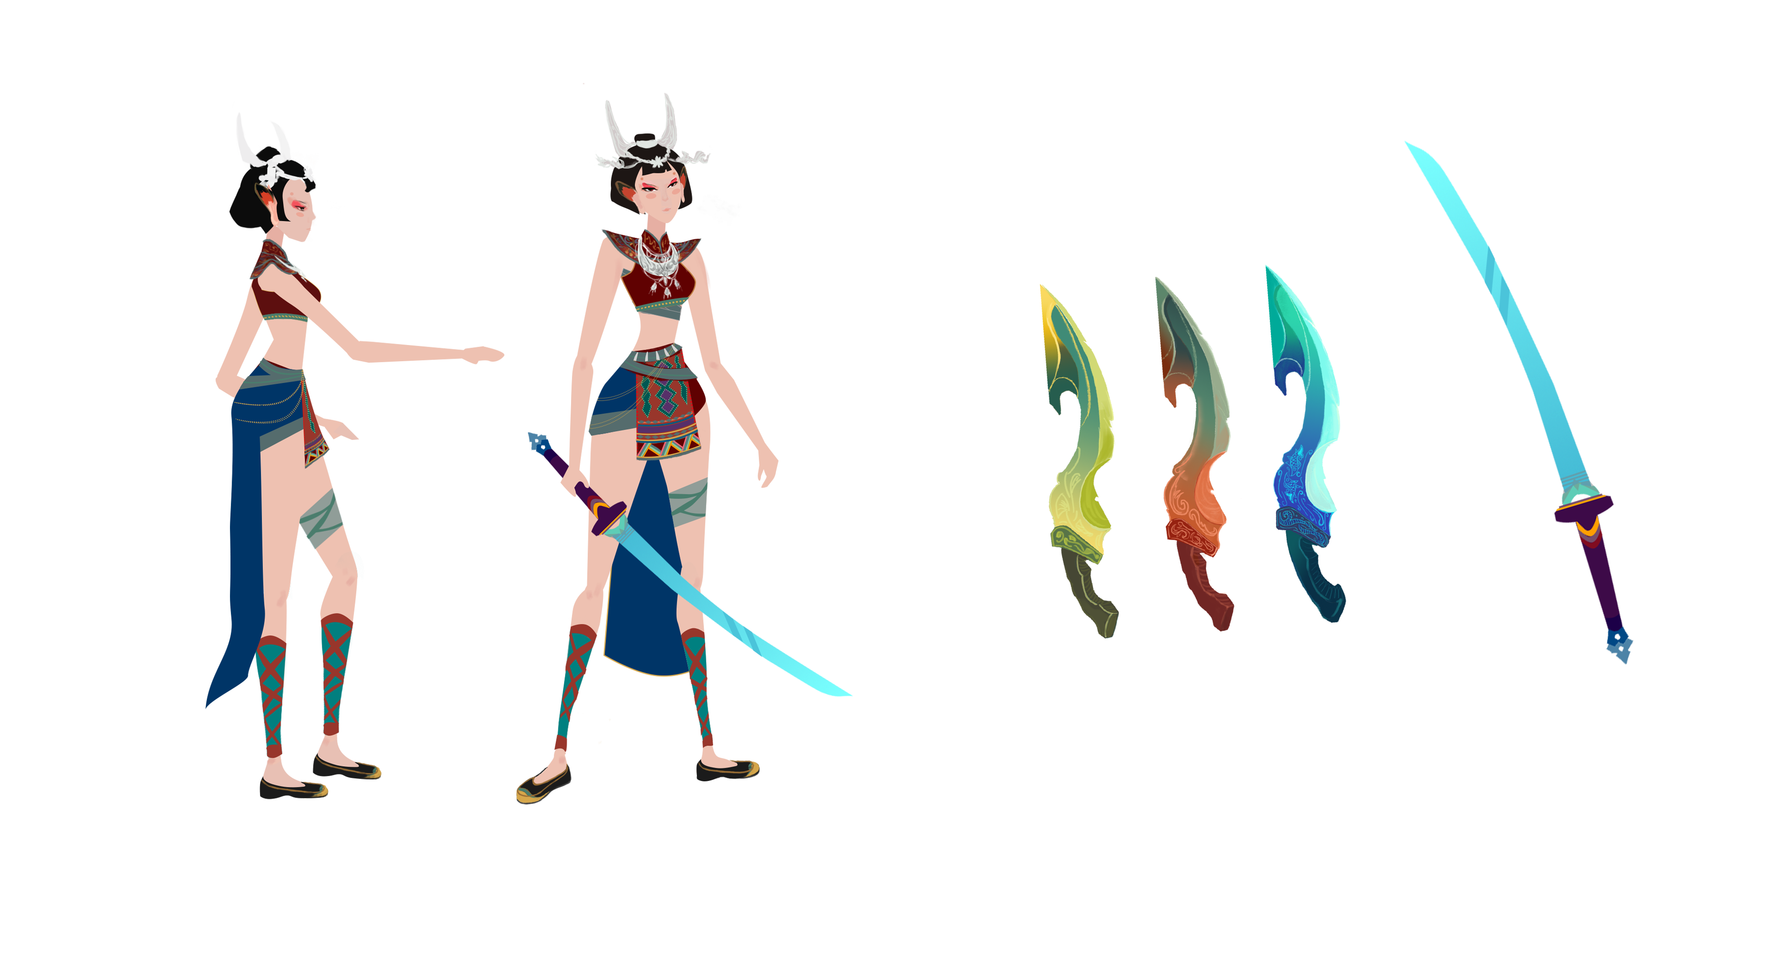
Character
Shaonv: the player character;
She had a mysterious life experience, beautiful style of dress and well-made katana indicate that she was born in a royal family.
With calm and silence, she has superb combat skills and a firm fight belief.
Can she achieve her goals through the whole journey?

Slide 5
Weapons
Fei Lian(Green), Jiang You(Red), Ping Yi(Blue) are the three soul blades.
These blades are named by the characters in ancient mythology.
Fei Lian has the power of Wind, Jiang You has the power of Earth and Ping Yi has the power of Water.
The personality, story, and power development of these three blades are also related to their powers of Elements.

Slide 6
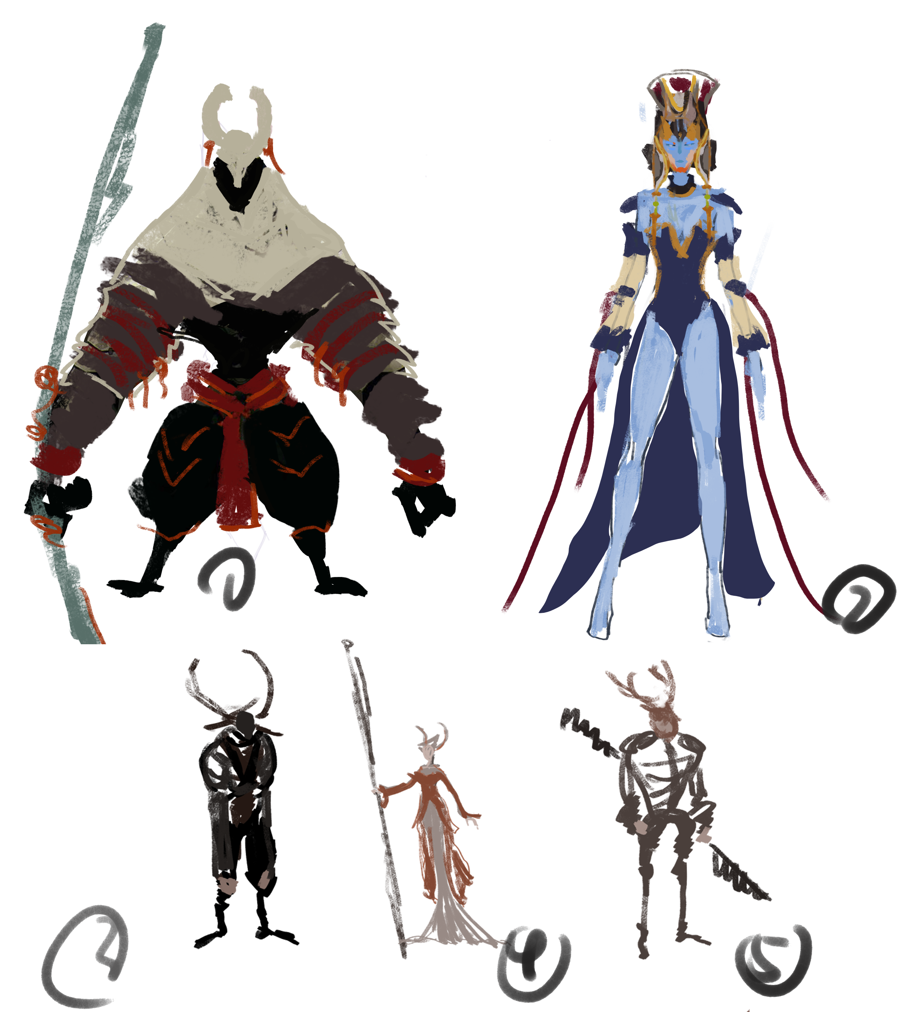
Boss concept
The concept and background of bosses come from the combination of Ancient myths and the tale of ‘Miao’.
The strong character develop from a special job in the tale of ‘Miao’, manipulating dead people going back home.
The female character develop from the daughter of ‘Huang di’, the first emperor of China.

Slide 7
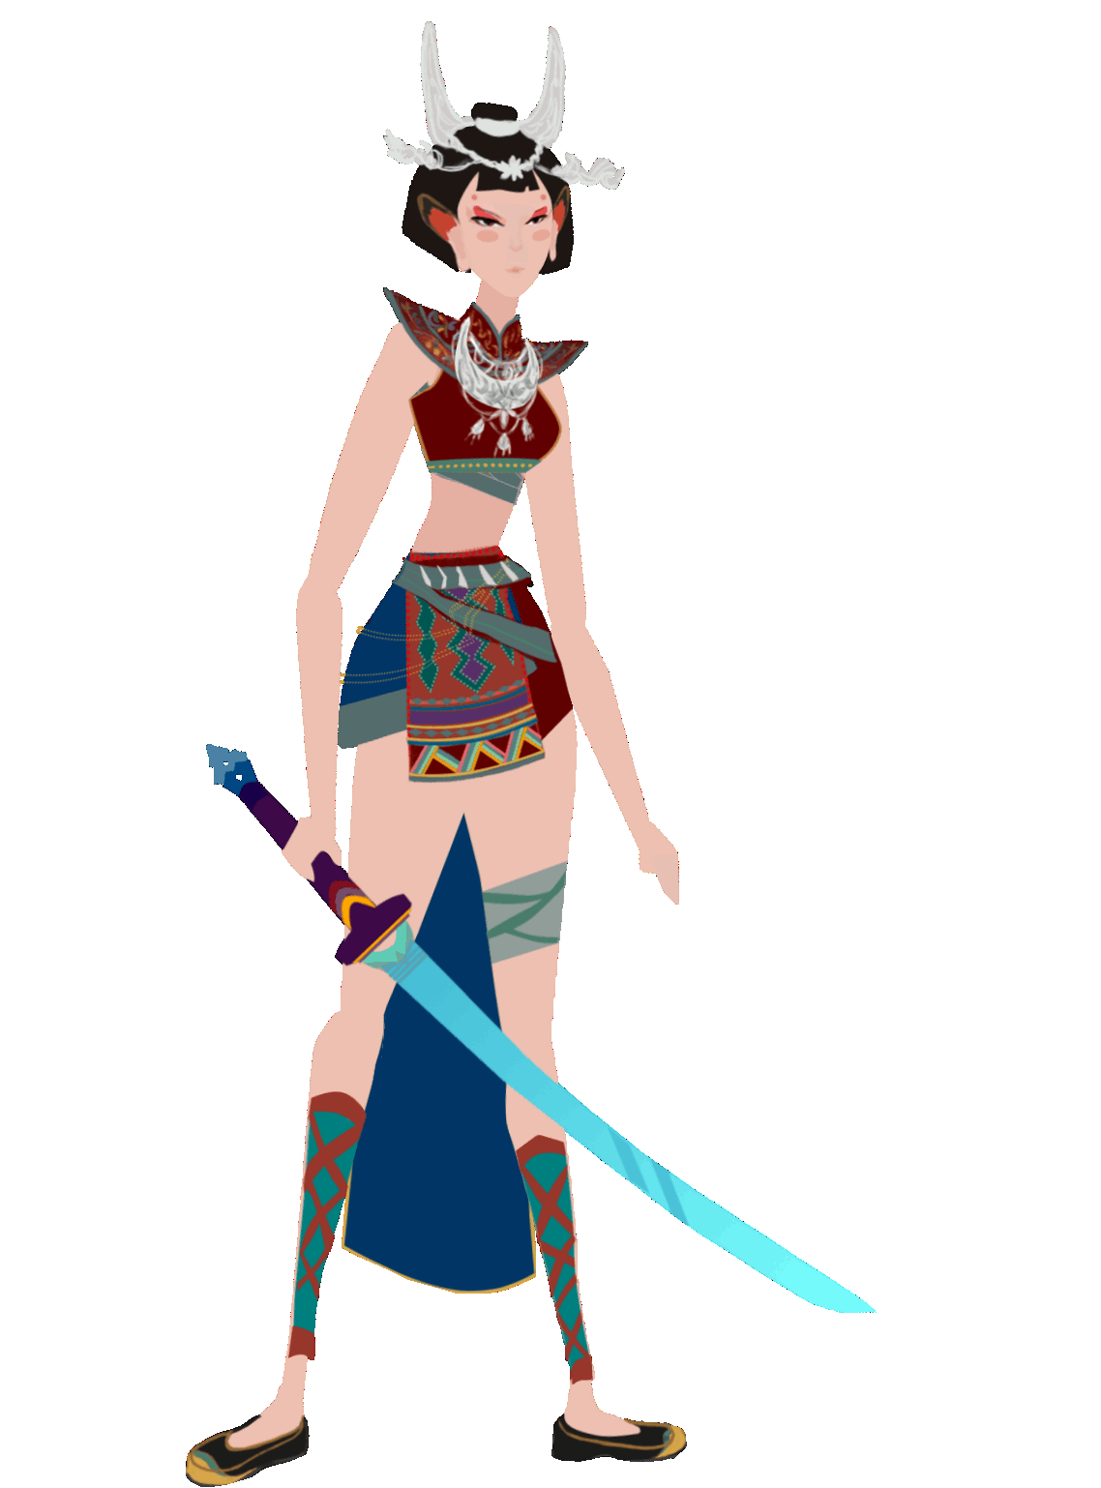
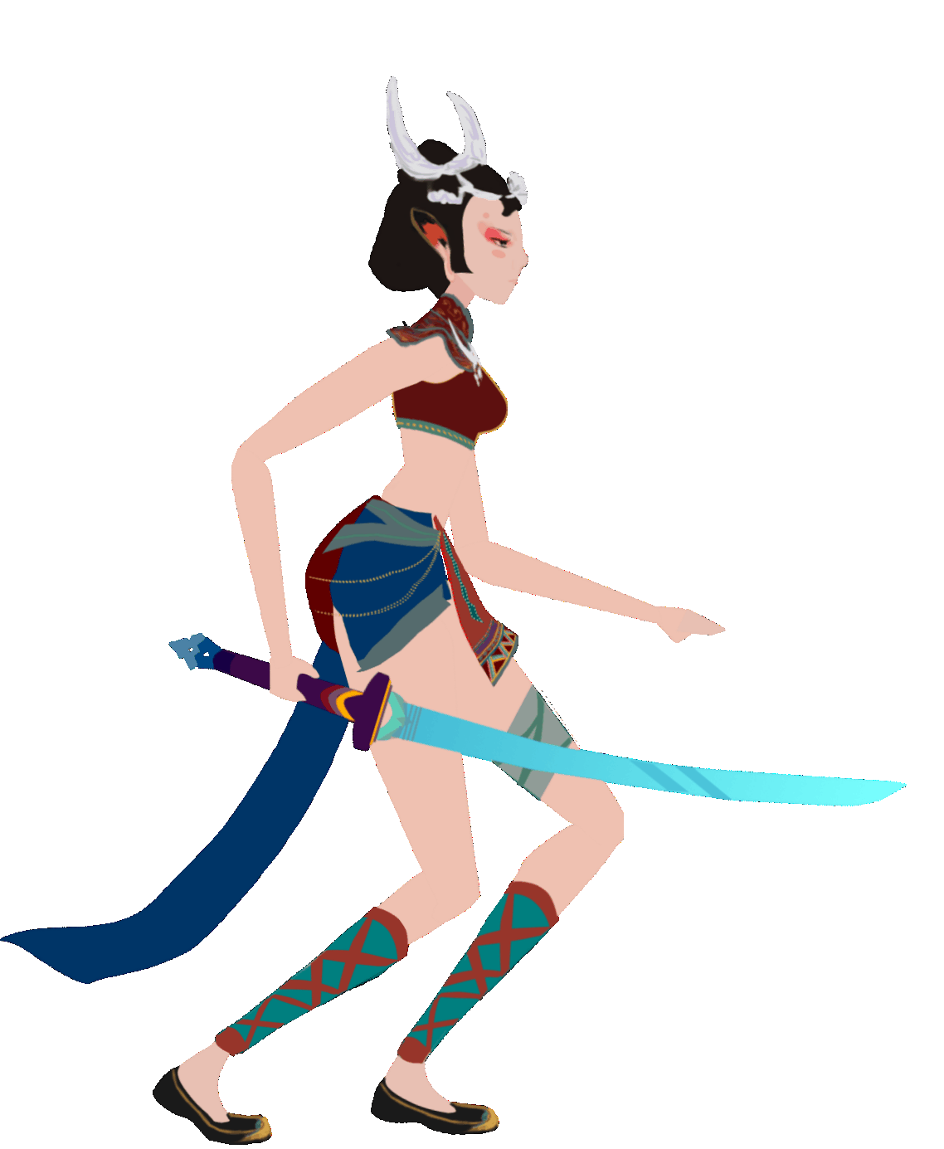
Animation: Idle (speed * 0.3)

Slide 8
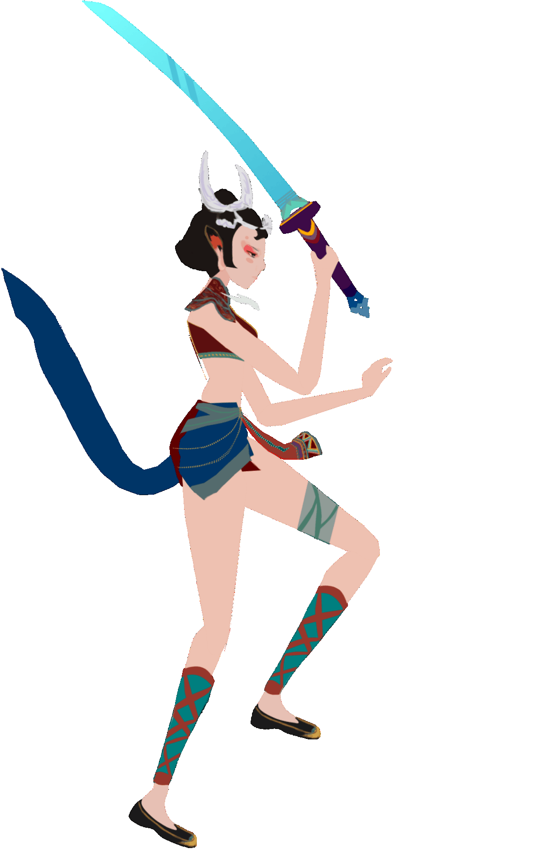
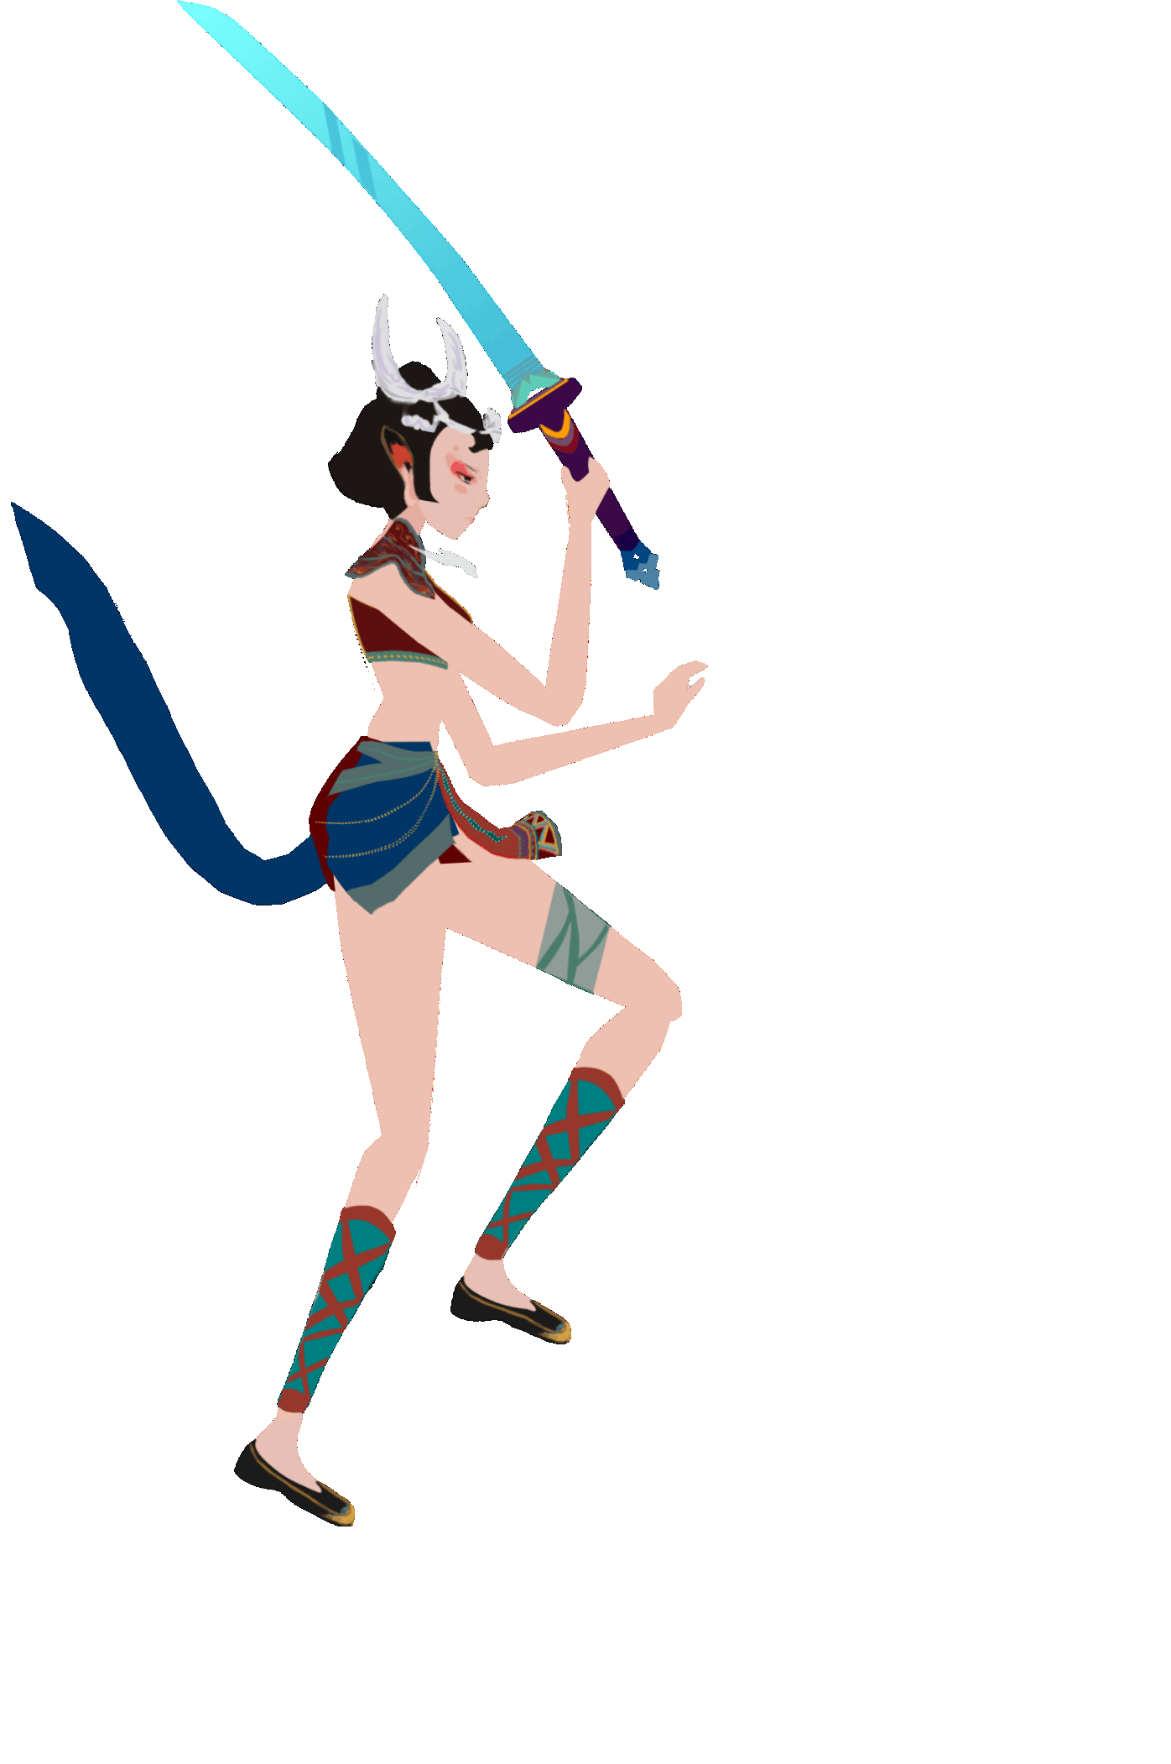
Animation: Drop down (speed * 0.3)

Slide 9
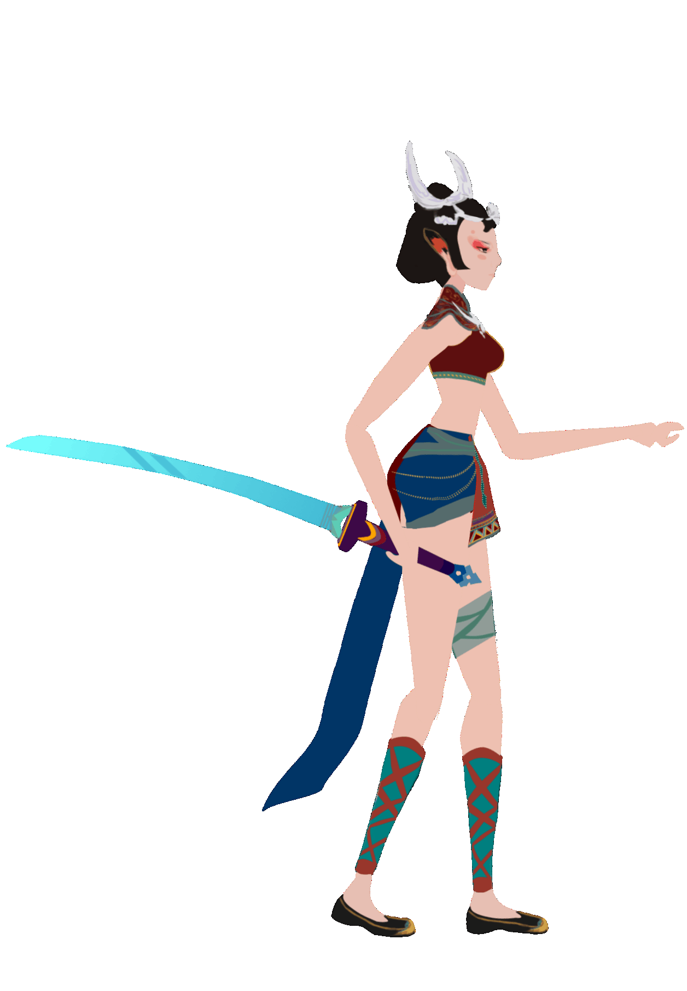
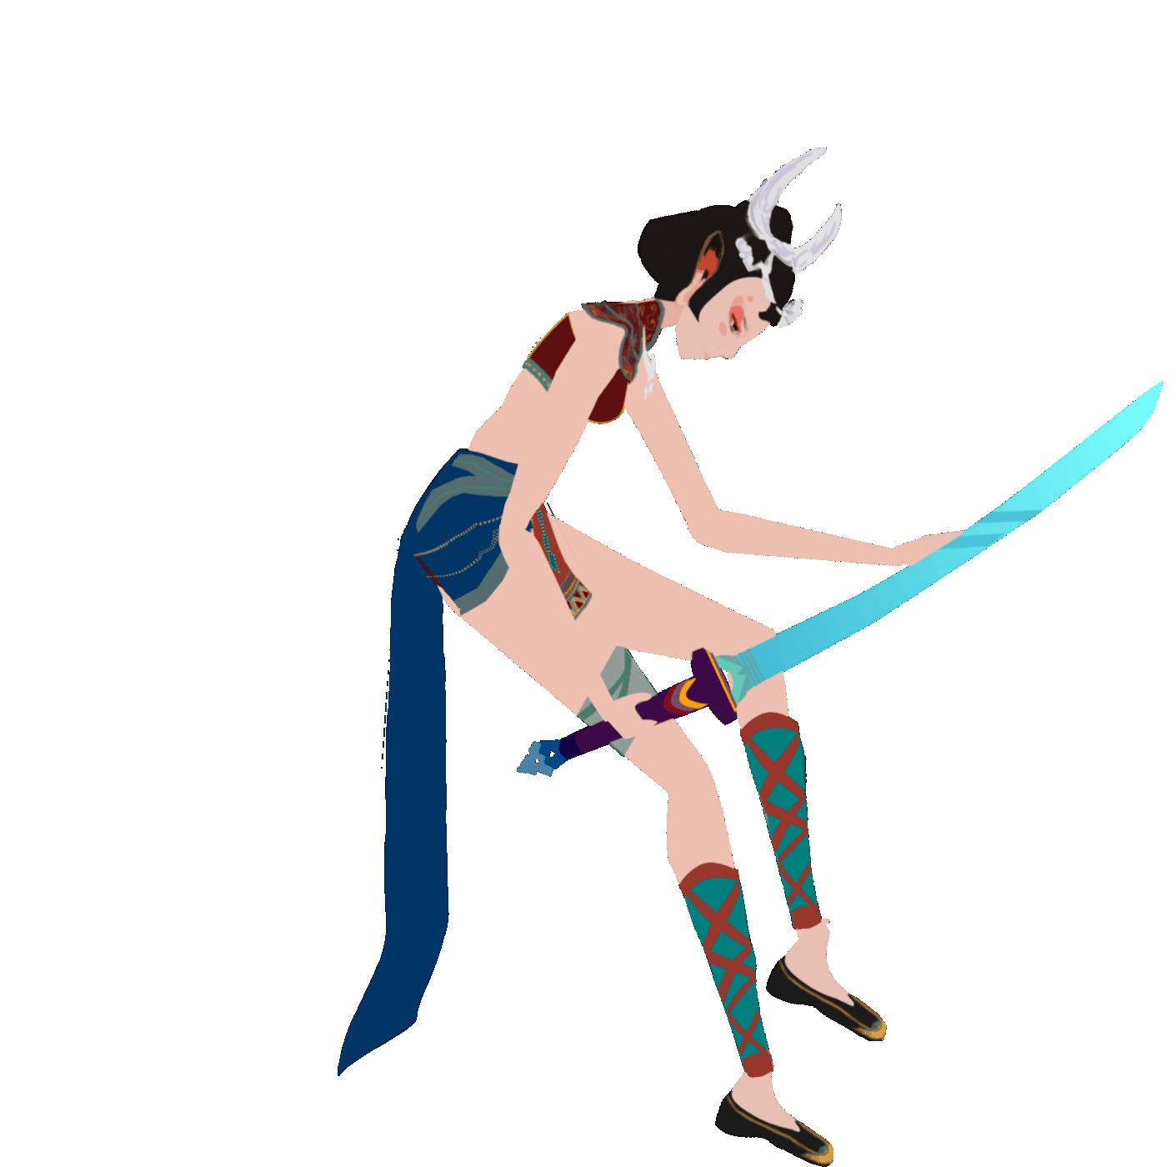
Animation: Jump/Get hit in sky (speed * 0.3)

Slide 10
Gantt Chart
Today

Slide 11
Conclusion
Our data research and Play test feedback proves that this action game proposal can appeal Chinese market audience, especially those players who are interested in Chinese culture.
Our team focus on this action game proposal, we are confident to finish this game as a whole and interesting production.
Our team have finished the Background settings, Story line, Character and weapons settings, Basic action system design, Programming frame, Playable prototype.
Our team are working on Bosses settings, Bosses skill design, Animation and the coding of whole combat system.
Our team have fully considered milestones for the α version implement on Day 40(05/07)

Slide 12
Thank You!

